Slide 1
Writable API
Satish Patel
caCORE SDK

Slide 2
Code Generation
Primary Key Generator
Cascade Settings
Eager Load Settings
Inverse-Of Settings
Not-Null Settings

Slide 3
Java API
CRUD Operations
Batch Operations
Transactions
Validation
Security
Portability of operations on the caGrid

Slide 4
Code Generation

Slide 5
Primary Key Generator
Requirement:
  Allow users to specify primary key generator per root class
Specification:
  Global setting for primary key generator will be specified in configuration file (deploy.properties)
  Class level setting will be specified in the UML model
  Assume global setting for any class which does not have a specific primary key generator assigned
  SDK will perform validation on the generator and the database combination to make sure they are suitable per hibernate specification

Slide 6
Primary Key Generator (contd…)
Tag Key | Tag Value | Example
NCI_GENERATOR.<database-type> | Increment, identity, sequence, hilo, seqhilo, uuid, guid, native, assigned, select, foreign | Tag = NCI_GENERATOR.Oracle Value = hilo
NCI_GENERATOR_PROPERTY1.<database-type> | <name-of-property>: <property-value> | Tag = NCI_GENERATOR_PROPERTY1.Oracle Value=table:hi_value
database-type – Suffix used in case of multiple database being supported through same UML model name-of-generator – Name of the primary key generator name-of-property – Name of the generator property as needed by Hibernate property-value – Value of the generator property

Slide 7
Cascade Settings
Requirement:
  Allow user to specify the combination of cascade setting on the association
Specification:
  Cascade setting will be specified on the association in the UML model
  SDK will perform validity check on the cascade setting value
  SDK will assume cascade setting of “none” if the user has not specified any particular setting
Tag Key | Tag Value | Example
NCI_CASCADE_ASSOCIATION# <FQCN>.<roleName> | <cascade-style-list> | Tag = NCI_CASCADE_ASSOCIAION.# A.myB Value=all,delete-orphan

Slide 8
Eager Load Settings
Requirement:
  Allow user to specify option of eagerly loading a particular association
Specification:
  Eager load setting will be specified on the association in the UML model
  SDK will assume associations are to be lazily loaded if eager load setting is not specified
Tag Key | Tag Value | Example
NCI_EAGER_LOAD# <FQCN>.<roleName> | Yes/no | Tag = NCI_EAGER_LOAD#A.myB Value=yes

Slide 9
Inverse-Of Settings
Requirement:
  Allow users to specify inverse-of setting which allows Hibernate to resolve the cycles in the object graph
Specification:
  Inverse-Of setting will be specified on the foreign key column of the association in the UML model

Slide 10
Inverse-Of Settings (contd…)
Association Type | Source Mapping (Table A) | Destination Mapping (Table B) | Generated Code
One-to-One † | NA | NA
One-to-Many † (A has many B) | NA | Tag = inverse-of Value = B.myA | A.hbm.xml <set name=”bCollection” inverse=”true”>
Many-to-One † (B has many A) | Tag = inverse-of Value = A.myB | NA | B.hbm.xml <set name=”aCollection” inverse=”true”>
Many-to-Many * (A has many B and B has many A) | Tag = inverse-of Value = A.bCollection | Tag = inverse-of Value = B.aCollection | A.hbm.xml <set name=”bCollection” inverse=”true”> B.hbm.xml <set name=”aCollection” inverse=”true”>
* One of the two should be used. * The tag is to be inserted on the column in the join table that maps to the association in the opposite direction. E.g. If there is a join table AB and B to A association is to be marked as inverse then in that case A_ID in the join table will contain the tag inverse-of with value A.bCollection. Only one of the two should be specified. † The tag is to be inserted on the foreign key column that maps to the association. when inverse-of tag is used, the generated HBM files will contain inverse = “true” for the corresponding association

Slide 11
Not-Null Settings
Requirement:
  Determine appropriate non-nullable foreign key columns for Hibernate mapping files
Specification:
  Use association multiplicity as an indicator for the non-null columns
    0..1 or 0 or 0..* means that foreign key column can be null
    1 or 1..* means foreign key column can not be null

Slide 12
Java API

Slide 13
Delete Object
Requirement:
  Allow users to delete object from the database
Basic sequence of operation to be fulfilled
  Client provides details of the object to be deleted
  SDK deletes the object
  SDK returns void
Hibernate takes care of updating the associations based on cascade and inverse-of settings

Slide 14
Delete Object
Delete Option 1 (SDK 4.1)
  Client provides object name and object id
  SDK performs the delete operation on the object
  SDK returns void
Delete Option 2 (Future Release)
  Client provides a example search query like CQL, NestedSearch, QBE
  SDK forms and executes the delete query
  SDK returns void

Slide 15
Create/Insert Operation
Requirement:
  Allow users to insert object (create record) in the database.
Basic sequence of operation to be fulfilled
  Create a object
  Save the object
  Return result object to the user

Slide 16
Insert Operation 1
Insert option 1 (SDK 4.1)
  Client creates and object
  Client attaches the associated objects and forms the object graph
  SDK saves the object graph
  SDK returns result object to client
Hibernate takes care of updating the associations based on cascade and inverse-of settings
Works fairly well for most SDK users
Difficult for grid users to implement when associations with Hibernate proxies can not be fetched from the server

Slide 17
Insert Operation 2
Insert Option 2 - (Future release)
Attach association and then insert object graph
  Client creates and provides object graph
  Client specifies way to fetch associated object based on the search query and attach the result to the already created object graph
  SDK performs “fetch and attach associations” function
  SDK saves the object graph
  SDK returns the result object to the client
Hibernate takes care of updating the associations based on cascade and inverse-of settings
Can be implemented for the grid users

Slide 18
Update Operation
Requirement:
  Allow user to perform update operation on object
Basic sequence of operation to be fulfilled
  Get a object
  Update attributes/associations of the fetched object
  Save the object
  Return result to the user

Slide 19
Update Operation 1
Update option 1 (SDK 4.1)
  Client retrieves object using search methods
  Client updates the attributes and association of the object
  SDK saves the object graph
  SDK returns the result object to the client
Hibernate takes care of updating the associations based on cascade and inverse-of settings
Problem with updating large associated collections
Difficult for grid users to implement when associations with Hibernate proxies can not be fetched from the server

Slide 20
Update Operation 2
Update attributes (Future release)
  Client provides a search query and attribute map
  SDK forms an update query based on attribute map and search query
  SDK executes the query
  SDK returns void
Update associations (Future release)
  Client provides a search query and associations to be nullified
  SDK forms and executes update query
  SDK returns void

Slide 21
Update Operation 3
Update Associations (Future release)
  Client provides example object to be updated
  Client provides map of associations to be fetched and attached to the example
  SDK perform “fetch and attach” operation for the association
  SDK executes update operation on the example
  SDK returns updated object

Slide 22
DML Style Operations
Insert/Update/Delete Operation
  Client specifies the DML operation in HQL syntax
  SDK executes the HQL
  SDK returns void
Hibernate takes care of updating the associations based on cascade and inverse-of settings
Problem with security enforcement

Slide 23
Miscelleneous

Slide 24
Batch Operation
Requirement:
  Allow users to specify more than one operations in single call
Basic sequence of operation to be fulfilled
  Client prepares a list of query operations
  Client invokes SDK’s service with query list
  SDK iterates through the list and executes all the queries one after other
  SDK returns response with status for success/failure

Slide 25
Security Configuration
Security to be enforced on each and every operations
Client can specify who can perform CREATE/UPDATE/DELETE on the domain objects using CSM configuration
Instance and Attribute level security can not be enforced on the writable API in current form

Slide 26
Validation of Data
Hibernate Validator
  No dependency on using Hibernate and can be used easily in business layer
  Annotations in the Java beans for the validation rules
  CDE information to be used to determine validation logic
  Initially limited to list of valid value only i.e. enumerated value domains
  Flexible to handle custom validation logic
  Inserted in the SDK service layer using AOP
Custom validation logic
  Can be inserted in SDK using AOP as well

Slide 27
Questions

Slide 28
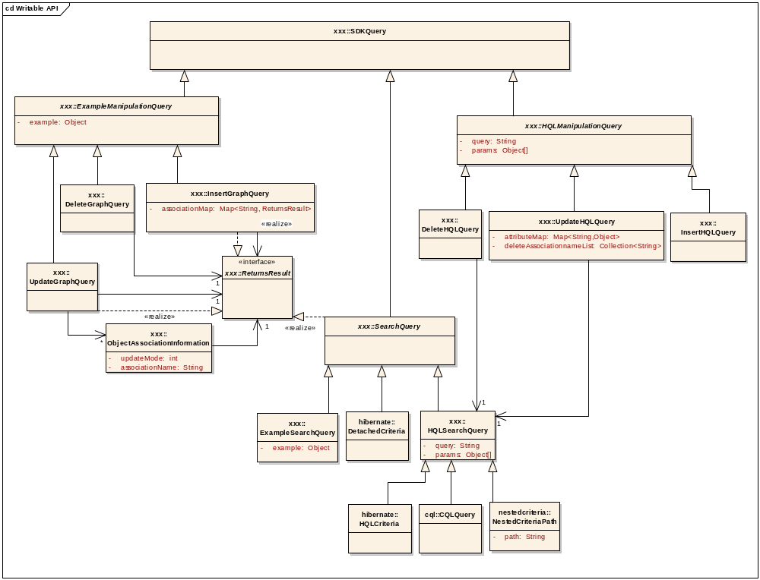

Slide 29
Use Cases
No | Use Cases | Module | Status
1 | Primary Key Generator | Code generator | Complete
2 | Cascade, Eager, Not-Null, Inverse-of | Code Generator | In Progress
3 | Insert Object | Java API
4 | Delete Object | Java API
5 | Update Object | Java API
6 | Batch Operations | Java API
7 | SDK’s Validation | Java API
8 | Custom Validation | Java API
9 | Security | Security

Slide 30
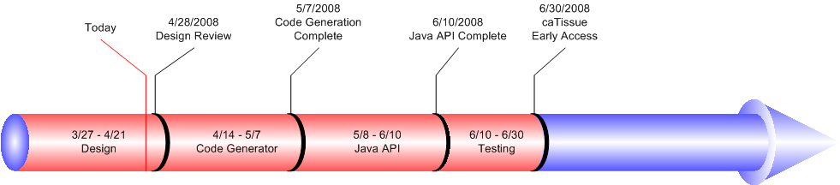
Timeline

